Slide 1
Solid State Bonding & Structure
OSU-SWJTU
Chemistry Lecture
Date: 2022.12.7

Slide 2
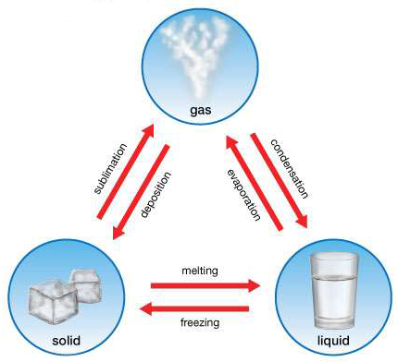


States of Matter
Gas (vapours)
Neither a definite volume nor a definite shape
Particles move freely and randomly in all the space available
Collide less often than in liquid
e.g. air, oxygen, helium, carbon dioxide, …
Liquid
Definite volume but not shape
Particles have some freedom and move around each other
Collide often
e.g. water, oil, blood, …
Solid
Definite shape & volume
Particles are packed closely together & moved slowly
Fixed positions & Regular structure
e.g. salt, sugar, diamond, crystals,…

Slide 3
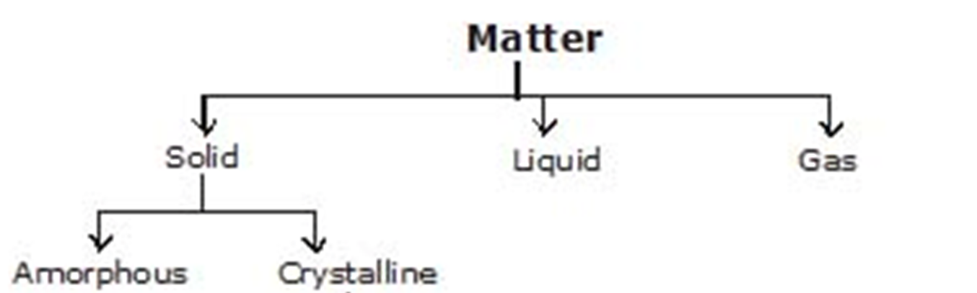
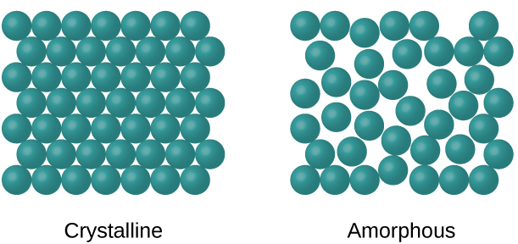
Crystalline Solids
Crystalline solids possess Regular, repeating geometric arrangements, can be studied more easily
Amorphous solids lack a well-defined arrangement (random arrangement)
Salts,
Diamond,
Sodium Nitrate,
…
Plastics, Glass, Rubber, PolymersWax,
…

Slide 4
Crystalline Solid
Molecular Crystalline Solid
Ionic
Crystalline Solid
Covalent Network Crystalline Solid
Metallic (Atomic ) Crystalline Solid
Positive and negative ions are held together by quite strong
electrostatic attractions
e.g. NaCl, NiO, CuO,…
The atoms are held together by a network of relatively strong covalent bonds
e.g. crystals of diamond, silicon, silicon dioxide (sand), …
The metal atoms held together by metallic bonds.
This structure is often described as a uniform distribution of atomic nuclei within a “sea” of delocalized electrons.
e.g. Cu, Al, Fe, Ni, …
Non-Polar
Polar
H- Bonded
The atoms or molecules are held together by weak dispersion forces or London forces.
e.g. Atoms (Ar, He, …)
Molecules(H₂, Cl₂, I₂ ,…)
The molecules are held together by relatively stronger dipole-dipole interactions.
e.g. HCl, SO₂,NH₃
These solids’ molecules have polar covalent bonds between H and F, O, or N atoms.
e.g. H₂O, NH₄OH

Slide 5
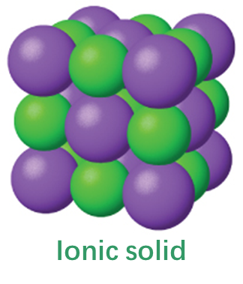
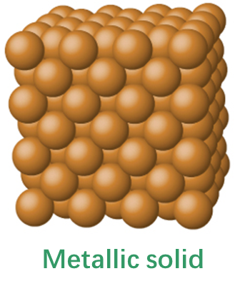
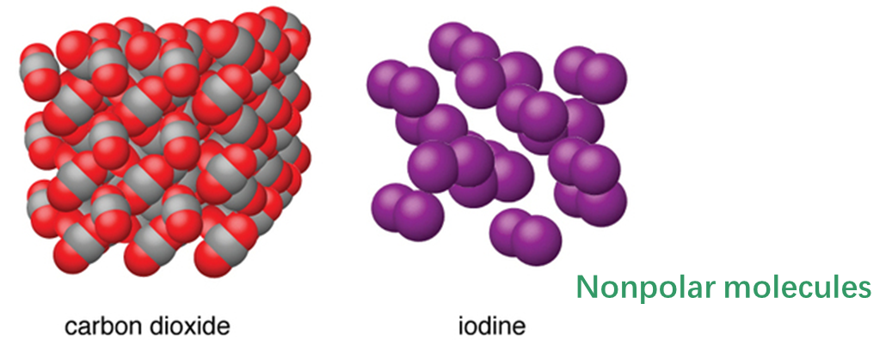
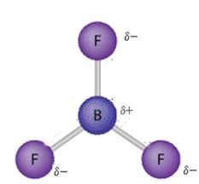
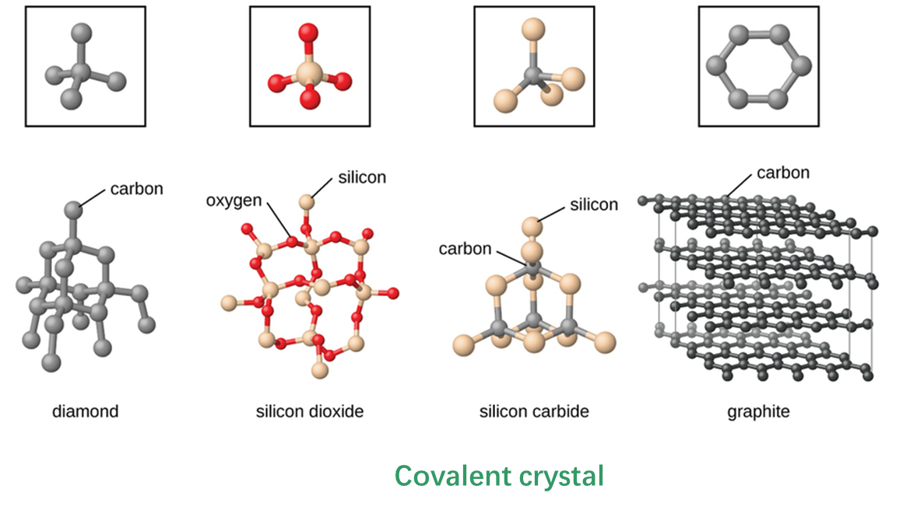
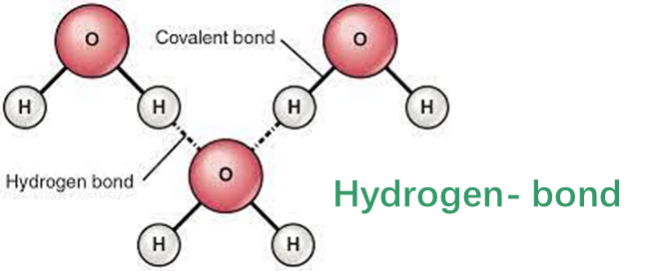
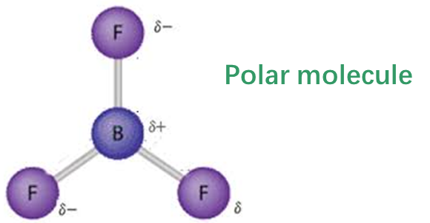

Slide 6
Which solids are electrical Conductive?

Slide 7
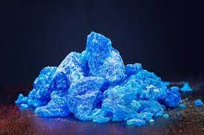
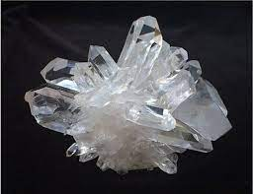
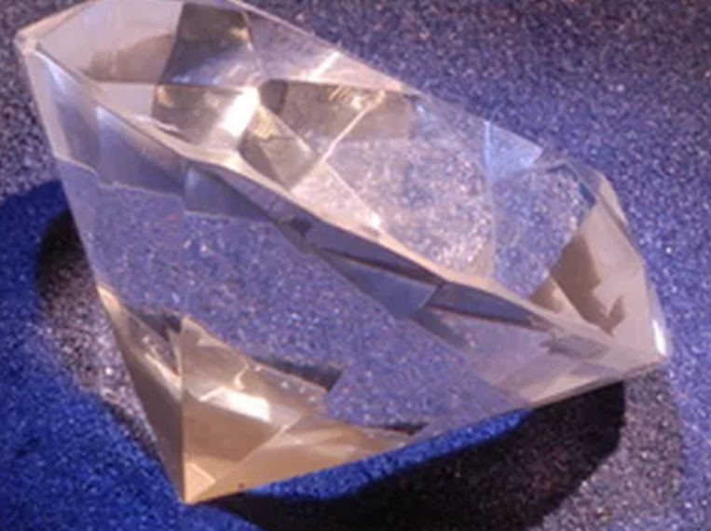
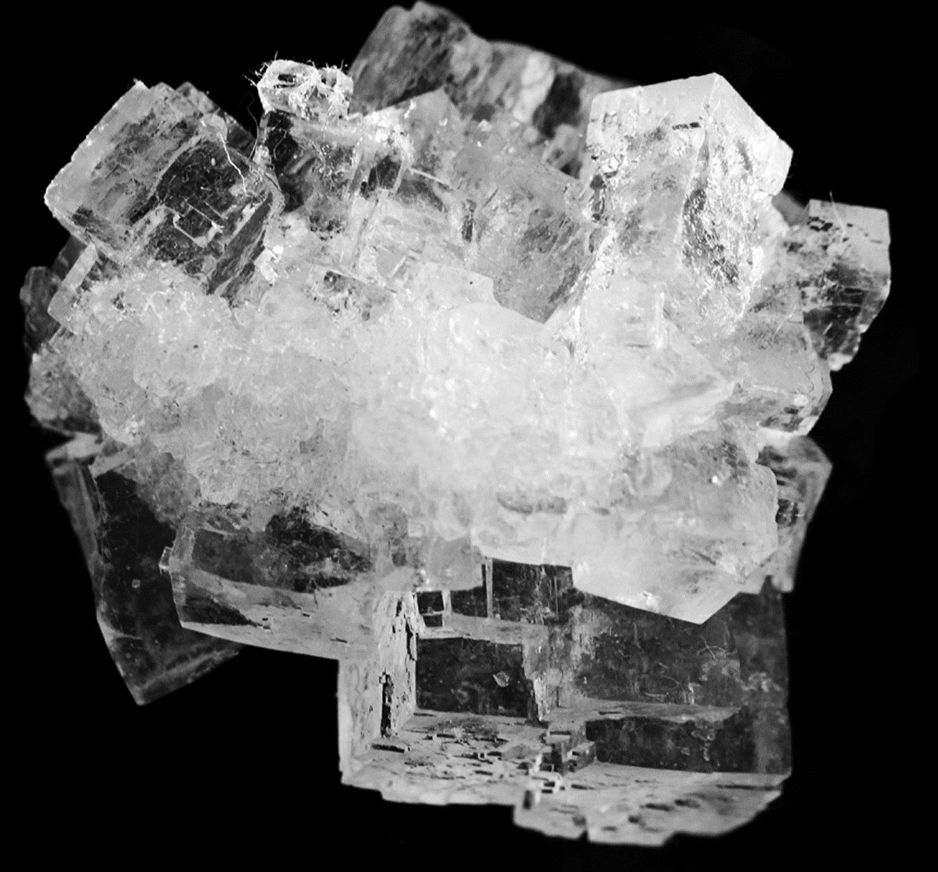
Crystalline solids
Crystalline solids possess rigid and long-range order; their atoms, molecules, or ions occupy specific positions.
The arrangement of atoms, molecules, or ions in a crystalline solid is such that the net attractive intermolecular forces are at their maximum.
The forces responsible for the stability of any crystal can be ionic forces, covalent bonds, van der Waals forces, hydrogen bonds, or a combination of these forces.
Copper sulfate
Quartz
Diamonds
Sodium Chloride

Slide 8
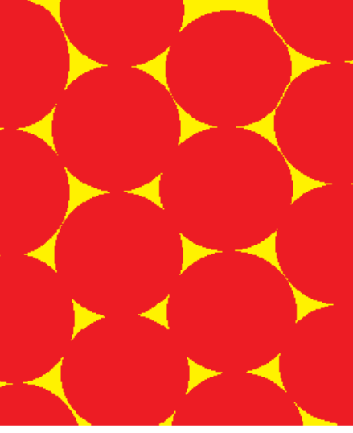
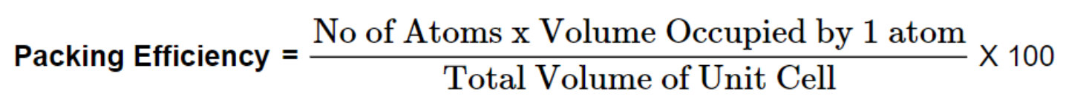
Packing Efficiency
2-dimensional (2D) arrangements
78.5%
90.7%
Line up rows
Offset Structure (Staggered)
The packing efficiency is the fraction of the crystal (or unit cell) actually occupied by the atoms.

Slide 9
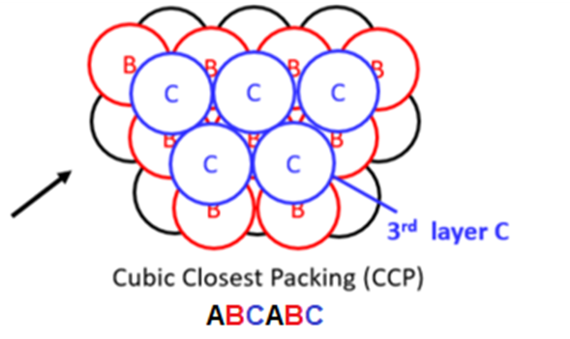
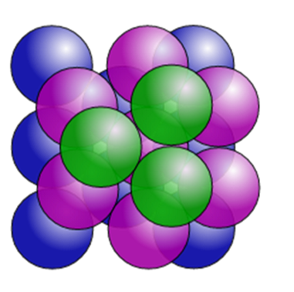
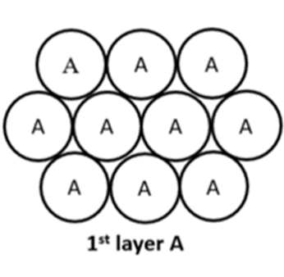
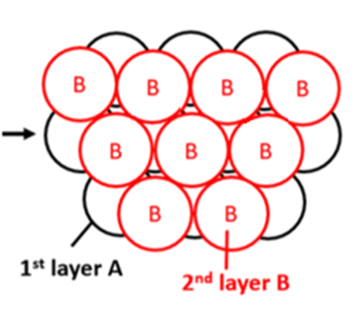
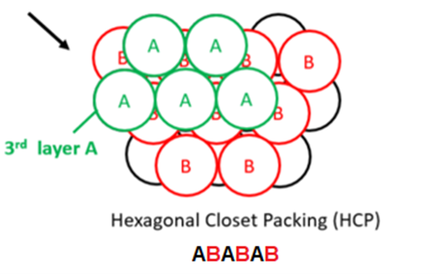
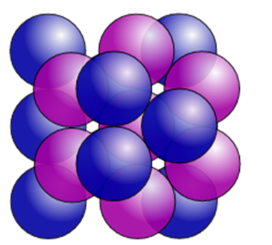
3-dimensional Packing Spheres (3D) To achieve maximum packing efficiency
face-centered cubic (fcc) or cubic close packed (ccp)
hexagonal close packed (hcp)

Slide 10
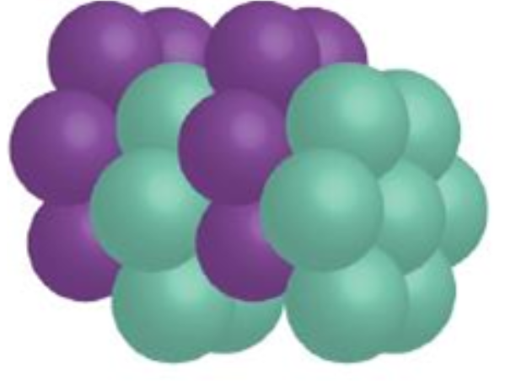
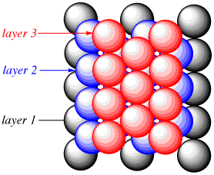
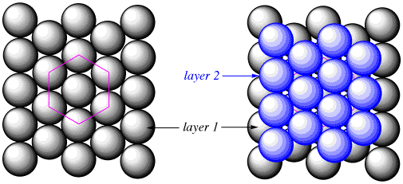
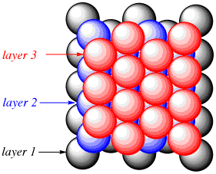
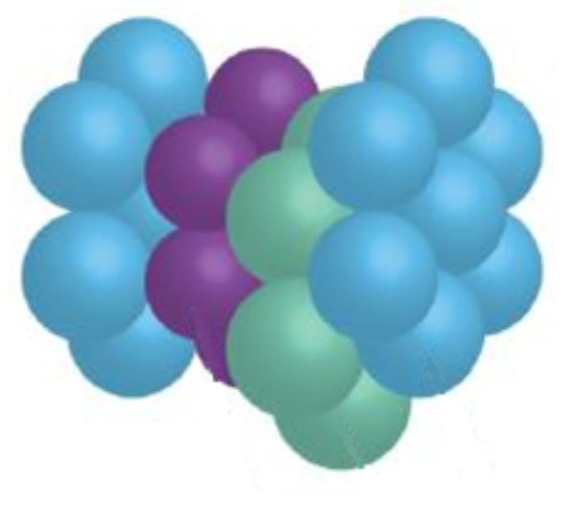
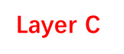
Layer C
Layer B
ABABAB
Layer A
Layer B
face-centered cubic (fcc) or cubic close packed (ccp)
Layer A
Layer B
ABCABC
Layer A
hexagonal close packed (hcp)

Slide 11
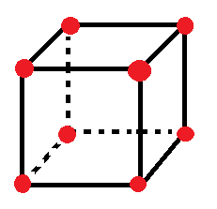
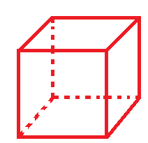
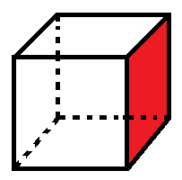
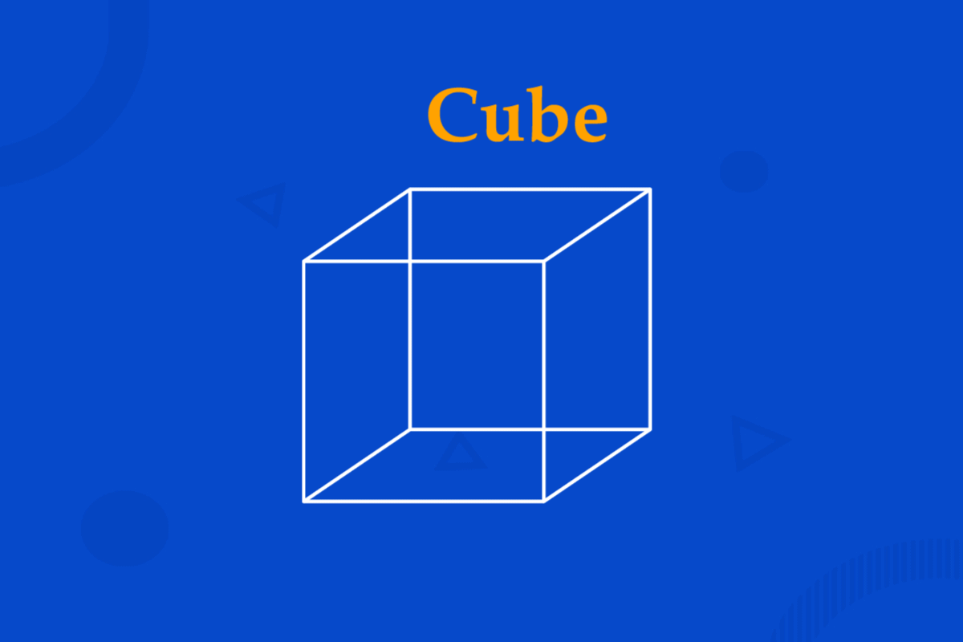
Cubic Structure
Vertex (Corner)
Edges (Straight line)
Faces
8
12
6

Slide 12
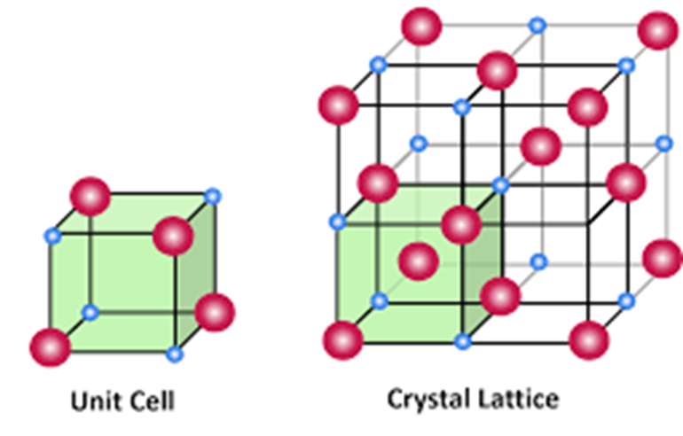
Coordination number (CN)
The number of atoms or ions immediately surrounding a central atom in a crystal.

Slide 13
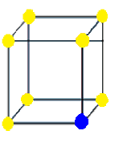
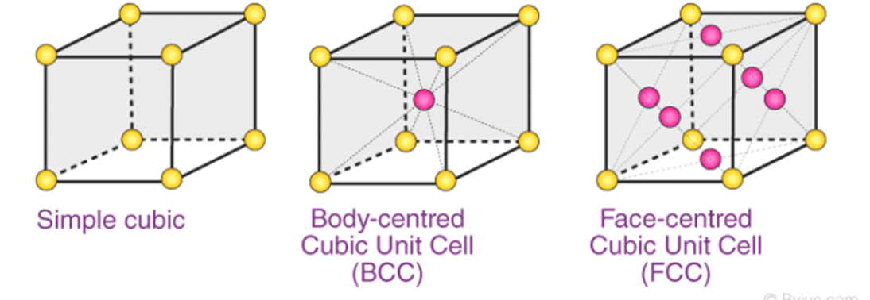
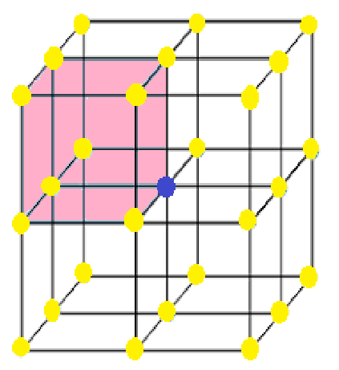
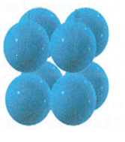
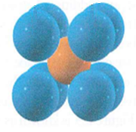
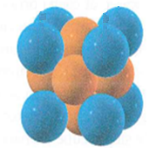
Types of Cubic Unit cells
Unit cell
Coordination number:
6
8
12

Slide 14
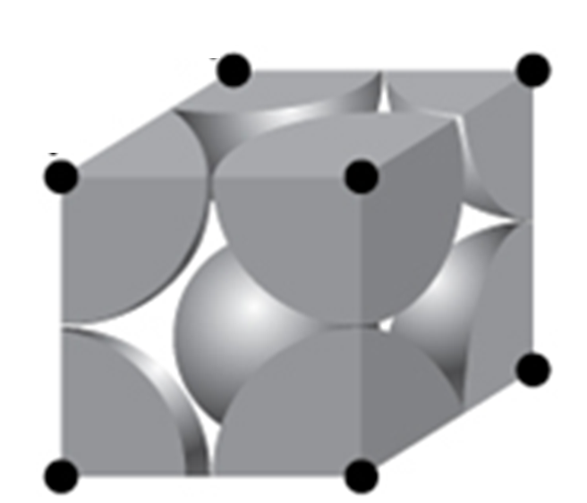
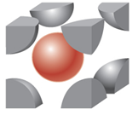
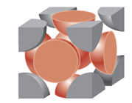
How many atoms are there in each unit cell?
Simple cubic
Body-centered cubic
Face- centered cubic
one-eighth of an atom at each of the eight corners
8×1/8=1 atom
one-eighth of an atom at each of the eight corners ( 8×1/8=1 atom)
one atom from the center
1+1=2 atoms
one-eighth of an atom at each of the eight corners ( 8×1/8=1 atom)
one-half of an atom on each of the six faces ( 6×1/2=3 atoms)
1+3=4 atoms

Slide 15
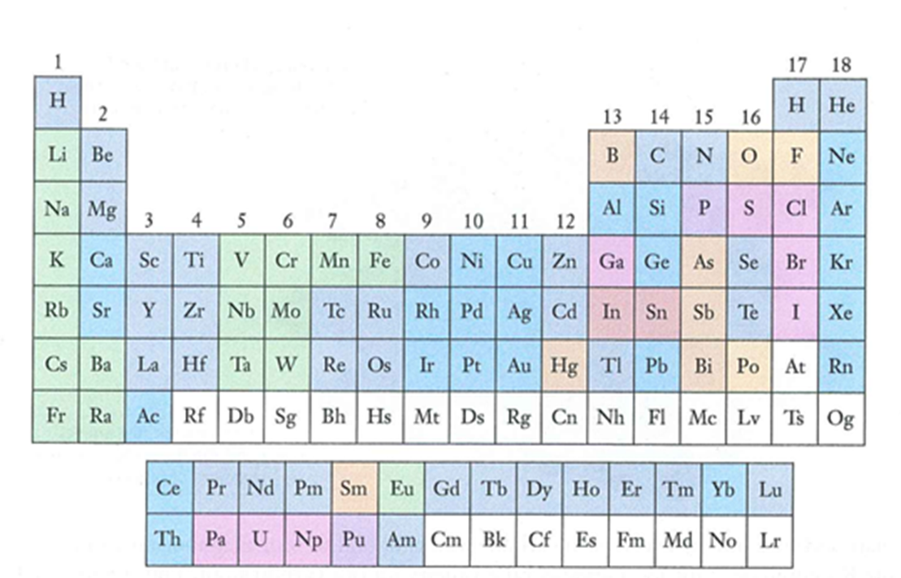
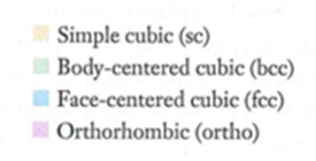
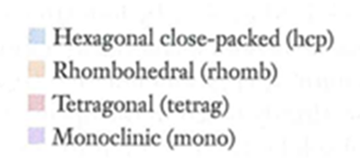
The most stable crystal structure for the solid states of the elements

Slide 16
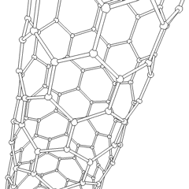
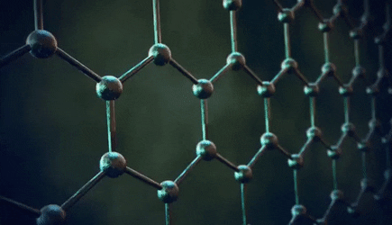
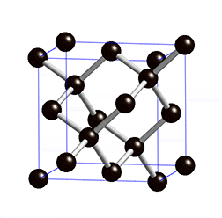
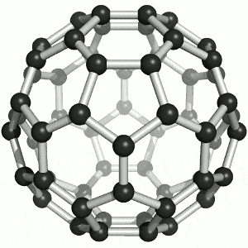
Structure of some carbon allotropes
Carbon nanotubes (CNT)
Graphite
Diamond
Fullerene (C60)

